Slide 1

Panel Presentation 1
Vidyavardhini’s College of Engineering & Technology
Department of Computer Science and Engineering (Data Science)
Academic Year: 2024-25
Jayesh Arjun 01
Puja Chafekar 05
Sachin Jadhav 16

Slide 2
Social Bot Detection
Abstract
Details of Papers
Hardware / Software required
ML-based WAF (Web application firewall)
Abstract
Details of Papers
Hardware / Software required
Motion Detection using background subtraction
Abstract
Details of Papers
Hardware / Software required

Slide 3
Topic -1 Social Bot Detection
Introduction
Prevalence and Complexity of Social Bots:
Social bots are automated software programs designed to mimic human behavior on social media platforms.
Growth Due to Social Media Adoption:
The widespread use of social media has facilitated the growth of social bots.
Bots are used for both benign purposes (e.g., customer service) and malicious activities (e.g., spreading misinformation).
Influence on Public Opinion:
Social bots can significantly influence public opinion and shape online discourse.
They amplify specific messages, create illusions of widespread support or opposition, and can sway political outcomes.

Slide 4
Importance of Maintaining Online Integrity:
Understanding the prevalence and impact of social bots is crucial for maintaining the integrity of online discourse.
Ensuring that social media remains an authentic space for human interaction requires ongoing advancements in detection algorithms and strategies

Slide 5
Literature Review
Sr. No | Title of Paper | Year | Advantages | Disadvantages
1 | A Social Bots Detection Model Based on Deep Learning Algorithm | 2021 | This method consists of three parts: social bot detection based on tweet joint features, social bot detection based on tweet metadata temporal features, and feature fusing. | One potential limitation of this paper is its focus on English language bots, which may limit its effectiveness in detecting bots that communicate in other languages.
2 | Twitter Bot Detection using Social Network Analysis | 2022 | The results show that the social network of real accounts has significantly more nodes and edges compared to bot networks. | As the number of nodes and edges in the graph increases, the computational resources required for analysis also increase significantly.
3 | Bot Conversations are Different: Leveraging Network Metrics for Bot Detection in Twitter | 2021 | The paper highlights the challenges in detecting bots due to their evolving nature and the sophistication of their behaviors. | Real-time detection remains a challenge due to the computational complexity and the need for immediate responses. It focuses on text-based features. Incorporating multi-modal data, could improve detection accuracy.

Slide 6
Aim & Objective
1. Identify challenges in social bot detection posed by AI-powered chatbots like ChatGPT.
2. Explore opportunities for innovative bot detection techniques leveraging AI advancements.
3. Examine best practices for social bot detection, emphasizing stakeholder collaboration and ethical considerations.
4. Discuss future directions in bot detection, including the adoption of explainable AI and human-in-the-loop approaches.

Slide 7
How do we detect a bot?
Some typical characteristics of bots on Twitter include:
Many Twitter bots have a relatively recent creation date.
Many bot user names contain numbers, which can indicate automatic name generation.
The account primarily retweets content, rather than tweeting original content.
The account’s tweet frequency is higher than a human user could feasibly achieve.
The account may have a high number of followers and also be following a lot of accounts; conversely, some bot accounts are identifiable because they send a lot of tweets but only have a few followers.
Many bots tweet the same content as other users at roughly the same time.
Short replies to other tweets can also indicate automated behavior.
There is often no biography, or indeed a photo, associated with bot Twitter accounts.

Slide 8
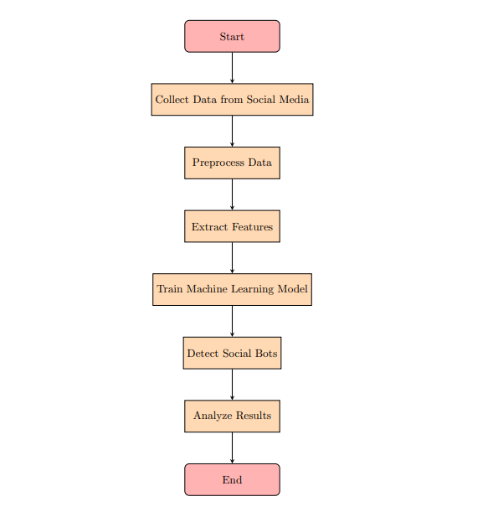

Methodology

Slide 9
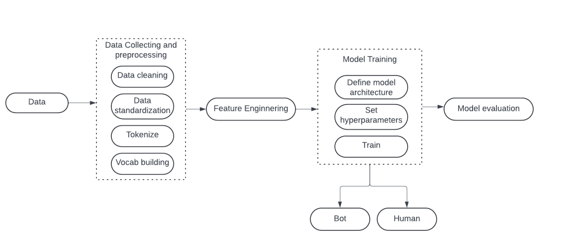
Design/Architecture

Slide 10
Technologies Used
Matplotlib: Used for data visualization, particularly for creating graphs and charts to analyze and present the results of our bot detection model.
TensorFlow: Employed for implementing deep learning algorithms, particularly for developing and training the LSTM model used in bot detection.
Pandas: Utilized for data manipulation and analysis, particularly for handling the Twibot-20 dataset and extracting relevant features for bot detection.
NumPy: Essential for numerical computing, particularly for handling arrays and matrices, which are fundamental for data manipulation and computations in our model.
scikit-learn: Used for machine learning tasks, particularly for implementing various classifiers and evaluation metrics for our bot detection model.

Slide 11
NLTK (Natural Language Toolkit): Applied for natural language processing tasks, particularly for text preprocessing and feature extraction from social media text data.
Torch (PyTorch): Employed for implementing deep learning algorithms, particularly for building and training neural networks for tasks such as image classification, natural language processing, and reinforcement learning.

Slide 12
Conclusion
In conclusion, our project represents a significant step towards addressing the pervasive issue of social bot detection on Twitter. Through the development and evaluation of LSTM-based and Random Forest models, we have demonstrated the efficacy of leveraging diverse data sources and machine learning techniques in distinguishing between genuine users and suspicious bot activity.
Moving forward, the future trajectory of research in social bot detection will focus on further refinement and validation of detection methodologies, including the integration of advanced techniques such as deep learning and ensemble methods.

Slide 13
ML-based WAF (Web application firewall)

Slide 14
Abstract:
This project presents a machine learning-based Web Application Firewall (WAF) developed in Python 3.8, designed to detect various web attacks such as SQL injection, cross-site scripting (XSS), path traversal, and command injection. The WAF is also capable of identifying long parameters, which may indicate parameter tampering attacks. Additionally, the project includes a simple REST service code that can be used as a target for testing the WAF. The model utilizes natural language processing techniques and a linear support vector machine learning algorithm, achieving a high detection accuracy rate of 99.53% with character n-gram methods. This approach demonstrates a significant improvement in web attack detection, ensuring robust protection for web applications.

Slide 15
Sr. No | Title of Paper | Year | Advantages | Disadvantages
1 | Web Application Firewall Using Machine Learning and Features Engineering | 2022 | The proposed model achieves high classification accuracy (91.8% for custom datasets and 94.6% for standard datasets. | The extracted features may not be generalizable for all web applications, requiring extensive logs to classify requests accurately.
2 | Artificial Intelligence Web Application Firewall for advanced detection of web injection attacks | 2023 | Effective feature engineering improved detection performance by using generalizable features | The model requires a massive log of an application to effectively classify requests, which might not be feasible for all applications​.
3 | Machine Learning Based Web Application Firewall | 2021 | The proposed model achieved an overall detection accuracy rate of 95.53%, demonstrating its effectiveness in detecting web attacks. | The model's effectiveness relies on comprehensive logs and may not generalize well across all web applications, limiting its applicability in diverse environments.

Slide 16
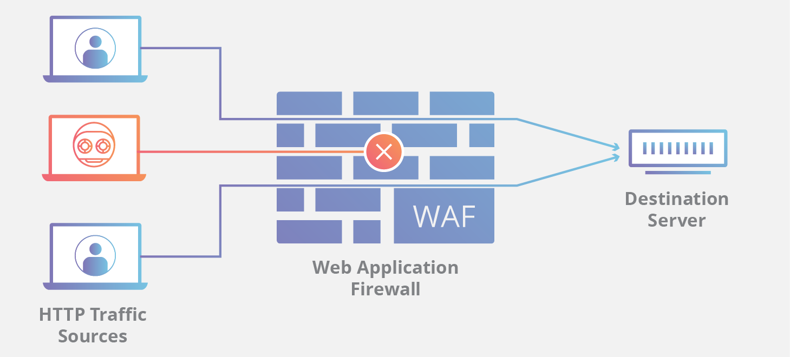
Diagram

Slide 17
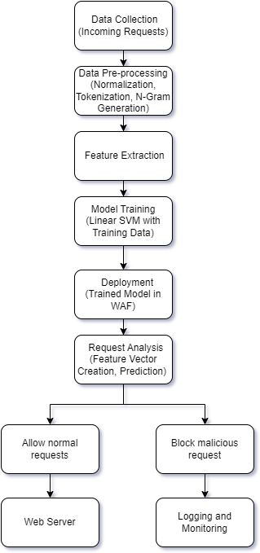

Slide 18
Example:
Imagine a user submitting a form on a website:
Normal Input: name=JohnDoe&age=25
Suspicious Input for SQL Injection: name=' OR 1=1; -- &age=25
Suspicious Input for XSS: name=<script>alert('XSS')</script>&age=25
Suspicious Input for Path Traversal: file=../../etc/passwd
Suspicious Input for Command Injection: name=JohnDoe; rm -rf / &age=25
The WAF uses these parameters to determine if the input data is trying to exploit the website. By analyzing patterns in the input data and comparing them with known attack signatures, the WAF can effectively detect and block malicious attempts.
N

Slide 19
Hardware and Software requirement:
Processor: Intel Core i5 or higher
RAM: 8 GB or higher
Storage: 20 GB free disk space
Operating System: Windows 10, macOS, or Linux
Programming Language: Python 3.8
Libraries and Frameworks:
Scikit-learn
NumPy
Pandas
Flask (for REST service)
Development Environment:
IDE (such as PyCharm, VS Code, or Jupyter Notebook)
Operating System Compatibility:
Windows, macOS, Linux
Additional Tools:
Version Control: Git
Package Manager: pip
Web Browser: Chrome, Firefox, or any modern web browser for testing the REST service
This setup ensures a conducive environment for developing, testing, and deploying the machine
learning-based web application firewall.

Slide 20
Conclusion:
We developed a machine learning-based Web Application Firewall (WAF) using Python 3.8 to detect web attacks like SQL injection, XSS, path traversal, and command injection. Utilizing natural language processing and a linear support vector machine, our WAF achieved a 99.53% detection accuracy with character n-gram methods. The inclusion of a simple REST service for testing validates its effectiveness, significantly enhancing web application security against various threats.

Slide 21
Summary:
Web Application Firewall (WAF): Protects websites from harmful data.
Detects Web Attacks: SQL Injection, XSS, Path Traversal, Command Injection.
Uses NLP and Character N-Grams: Breaks down data into smaller parts to analyze patterns.
Linear Support Vector Machine (SVM): Draws a line to separate good data from bad data.
High Accuracy: Detects attacks correctly 99.53% of the time.

Slide 22
Topic 3 : Motion Detection using background subtraction

Slide 23
Abstract
Motion detection is a critical component in various applications such as surveillance systems, human-computer interaction, and autonomous vehicles. Background subtraction is a popular technique for detecting moving objects in video sequences. It involves modeling the background scene and identifying changes by comparing each frame with the background model. This project aims to develop an efficient motion detection system using background subtraction techniques.

Slide 24
Details of Paper
Sr. No | Title of Paper | Year | Advantages | Disadvantages
1 | Improved Adaptive Gaussian Mixture Model for Background Subtraction. | 2018 | Robustness: The model adjusts parameters automatically based on the input, making it robust against various types of background changes. | It does not address real-time performance optimization or the system's scalability when applied to high-resolution video streams and large-scale surveillance systems.
2 | An improved background subtraction algorithm based on a combination of Bayesian and fuzzy theory. | 2019 | Accuracy: Combines Bayesian and fuzzy logic to enhance the accuracy of background subtraction, particularly in complex environments. | the computational complexity of combining these approaches is high. The paper lacks an exploration of lightweight, real-time implementations suitable for resource-constrained environments such as edge devices.
3 | Improving motion detection by using spatial and temporal context in background subtraction. | 2019 | Easy to implement and computationally lightweight, which is beneficial for practical applications. | However, it does not thoroughly investigate the impact of varying environmental conditions such as extreme weather, night-time, or crowded scenes.

Slide 25
Methodology
Video Capture:
Capture video frames from a camera.
Background Modeling:
Create a model of the background by analyzing a series of frames.
Foreground Detection:
Subtract the current frame from the background model.
Identify significant changes as foreground objects (moving objects).
Post-processing:
Apply morphological operations to reduce noise and enhance the detected motion regions.

Slide 26
Hardware/Software Used:
Hardware:
Camera for video capture.
Computer with GPU for faster processing.
Software:
Programming languages: Python, C++.
Libraries: OpenCV, NumPy.
IDE: PyCharm, Visual Studio Code.

Slide 27
Conclusion
Motion detection using background subtraction techniques is a pivotal technology with widespread applications in areas such as surveillance systems, human-computer interaction, and autonomous vehicles. This method involves detecting moving objects by distinguishing them from the static background in video sequences.

Slide 28
Thank you

